Slide 1
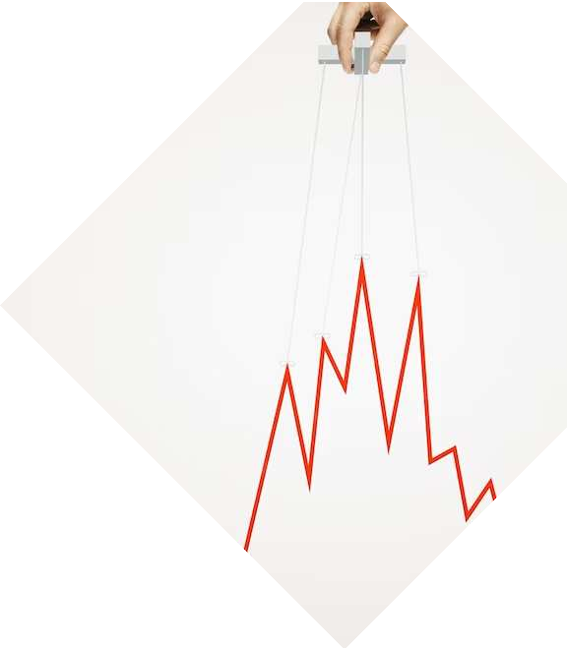
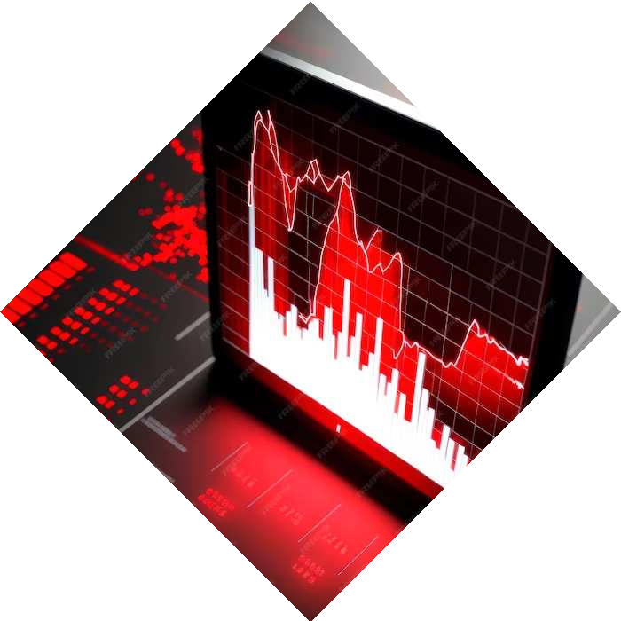
Exploratory Data Analysis of Bank Stocks from the Financial Crisis to Early 2016

Slide 2
Introduction
In this data project we will focus on exploratory data analysis of stock prices.
We’ll focus on bank stocks and see how they progressed throughout the (financial crisis) all the way to early 2016.

Slide 3


We need to get data using pandas datareader.
We will get stock information for the following banks:
Bank of America CitiGroup Goldman Sachs JPMorgan Chase Morgan Stanley Wells Fargo
We will use Data reader for extracting the stock price information

Slide 4
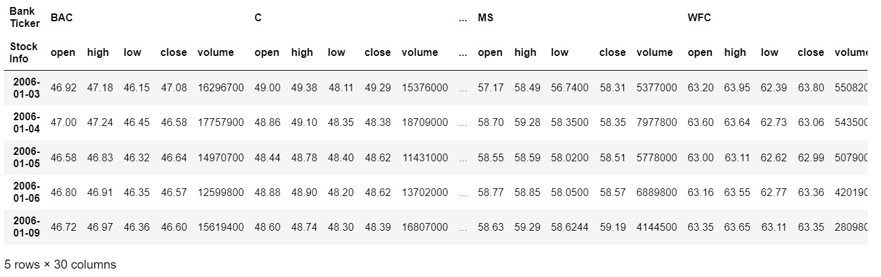
Dataframe

Slide 5
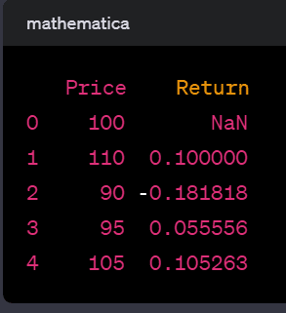
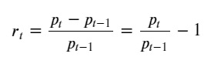
PCT
In this example, the “Return” column is created using .pct_change(), and it represents the percentage change from the previous row for the “Price” column. The first row of the “Return” column is NaN (Not a Number) because there is no previous value to calculate the percentage change from. In the context of financial data, you might use .pct_change() to calculate daily or periodical returns based on stock prices. For example:

Slide 6
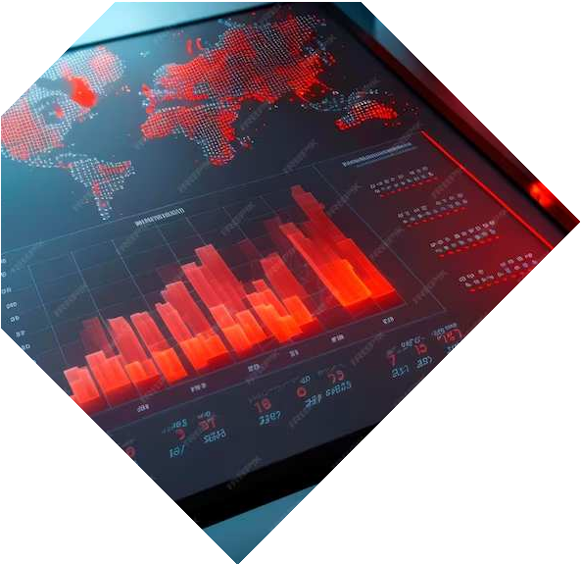
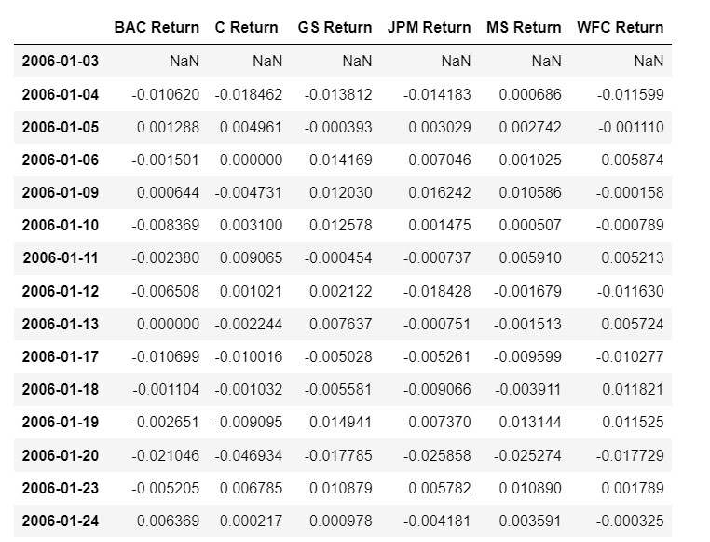

Return PCT Change

Slide 7
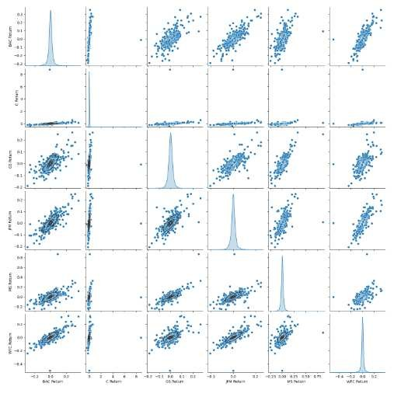
Analysis
The resulting pairplot is a grid of subplots where each variable in the DataFrame is compared to every other variable. The diagonal of the grid shows the univariate distribution of each variable using histograms or kernel density estimates.

Slide 8
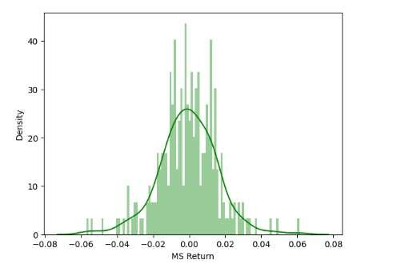
Plot will show the distribution of returns for Morgan Stanley stock during the specified time period. The histogram provides an overview of how frequently different ranges of returns occur, and the kernel density estimate provides a smoothed representation of the distribution. The color ‘green’ is chosen for the histogram bars. Adjusting the number of bins can influence the level of detail in the histogram.

Slide 9
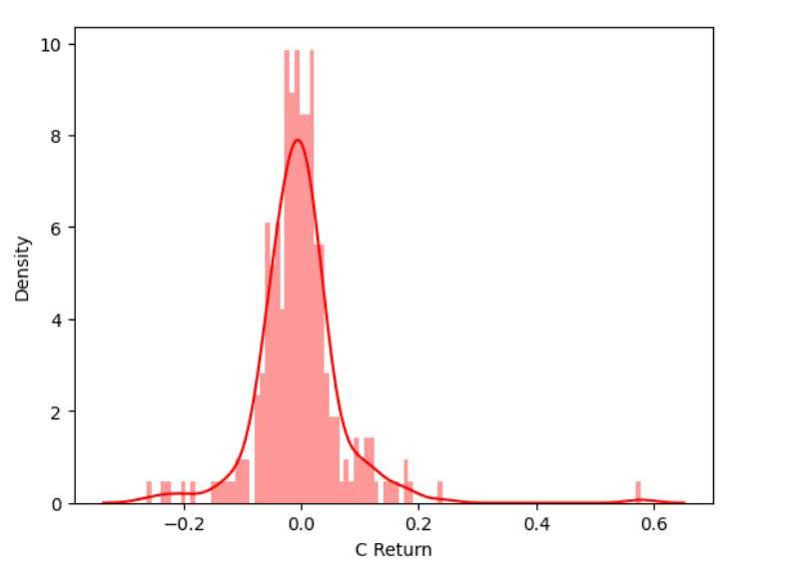
The resulting plot will show the distribution of returns for CitiGroup stock during the specified time period. The histogram provides an overview of how frequently different ranges of returns occur, and the kernel density estimate provides a smoothed representation of the distribution. The color ‘red’ is chosen for the histogram bars.
Adjusting the number of bins can influence the level of detail in the histogram.

Slide 10
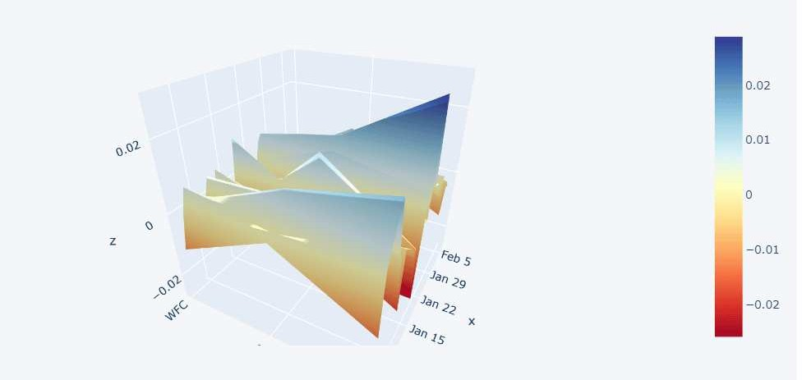
3D surface plot with three variables ('JPM', 'MS', 'WFC') on the axes. The color represents the values of the returns for each stock at different points in the dataset. The 'rdylbu' color scale helps visualize variations in the returns across the three stocks. Note: Make sure you have previously run cf.go_offline() to enable offline mode for Plotly in Jupyter Notebooks, as this is required for the iplot function to work.

Slide 11
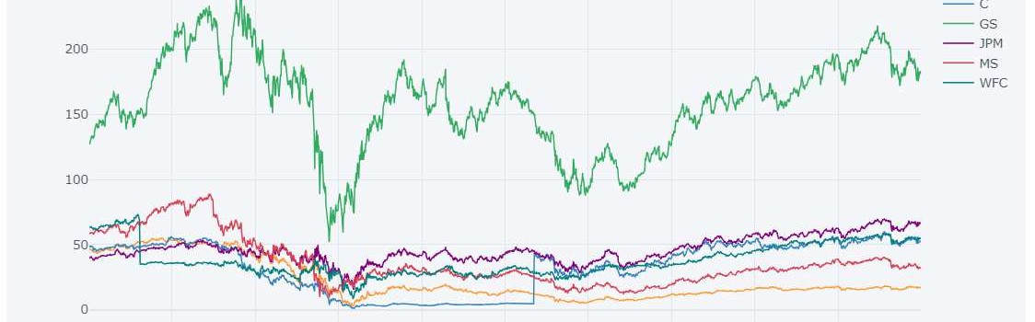
The resulting plot is likely an interactive line chart where each line represents the closing prices of a different bank over time. Users can interact with the plot, zoom in/out, pan, and get additional information by hovering over data points. Make sure you have previously run cf.go_offline() to enable offline mode for Plotly in Jupyter Notebooks, as this is required for the iplot function to work.
Additionally, ensure that you have the necessary libraries installed (cufflinks, plotly). If not, you can install them using:

Slide 12



Thanks!
deepakgarg@gmail.com nishkamehlawat@gmail.com amishunegi@gmail.com

